Slide 1

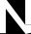
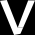
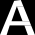
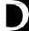
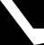
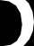
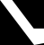
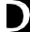
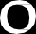
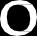
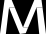
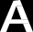
1

Slide 2
How to tackle Imbalance?
Imbalance in Deep Learning

Slide 3
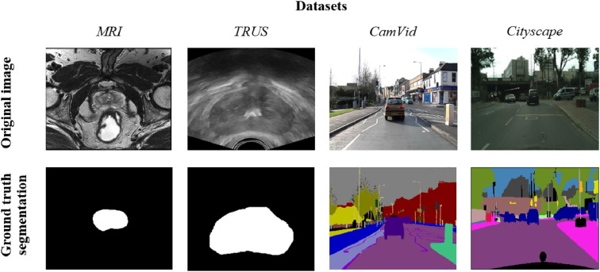
What is Imbalance?
Within an image, only a portion of it corresponds to the feature of interest; this is the positive class. The rest of the image is usually assigned to another category or negative class (in many cases “background”), although there are also several other classes. In general, computer vision, as well as digital image analysis, tend to be fields with a high degree of data imbalance. [1]

Slide 4
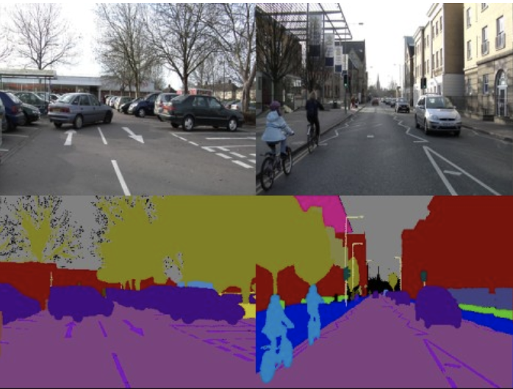
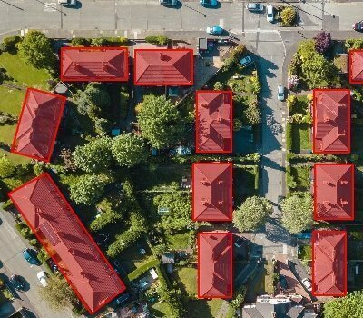
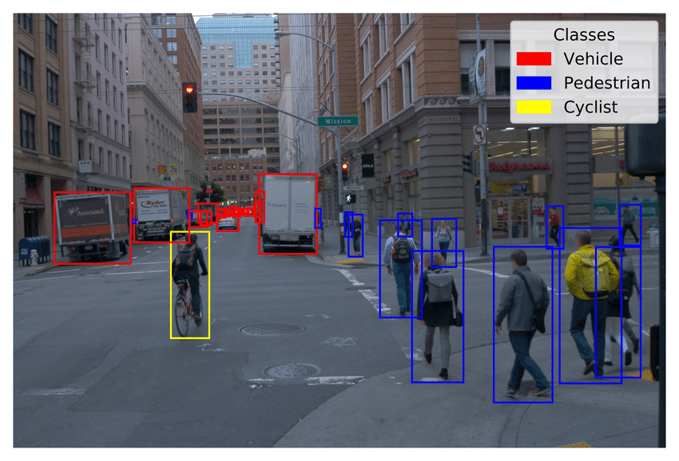
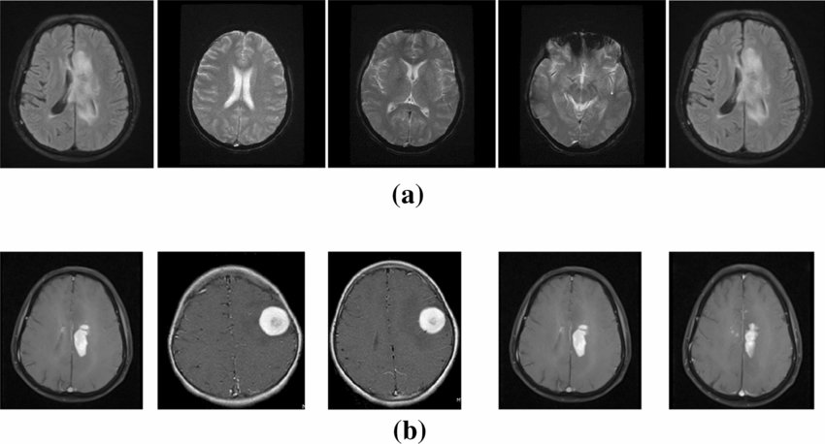
Some examples…
Medical Imaging: tumor regions or anomalies vs normal tissue.
Urban Scene Understanding: classes such as buildings, roads, or vegetation vs traffic lights, pedestrians, or street signs.
Object Detection: the number of pixels belonging to object regions is typically much smaller compared to the background.
Aerial Imagery: classes like buildings or roads vs small vehicles or individual trees.
Natural Scene: certain classes like sky, grass, or water vs animals, trees, etc.
Risk management: classes like land, or forest vs landslide, floods.

Slide 5

Analyze the following case:
Information has been collected from 100,000 people who have been associated with a new disease that is plaguing the country.
It was confirmed that 5,000 of those people have the disease and the rest are healthy people.
The information that was collected from each person involves both demographic data and data clinical.
These data were pre-processed and with them trained a binary classifier that given the data of a patient determines whether or not the patient has the illness.
The resulting classifier obtained a precision of 95%, that is, he was wrong only in 5% of the data.
 | Sick Prediction | Healthy Prediction
real sick | 0 | 5000
real healthy | 0 | 95000
What opinion can you give of the classifier?
Is that classifier good?

Slide 6
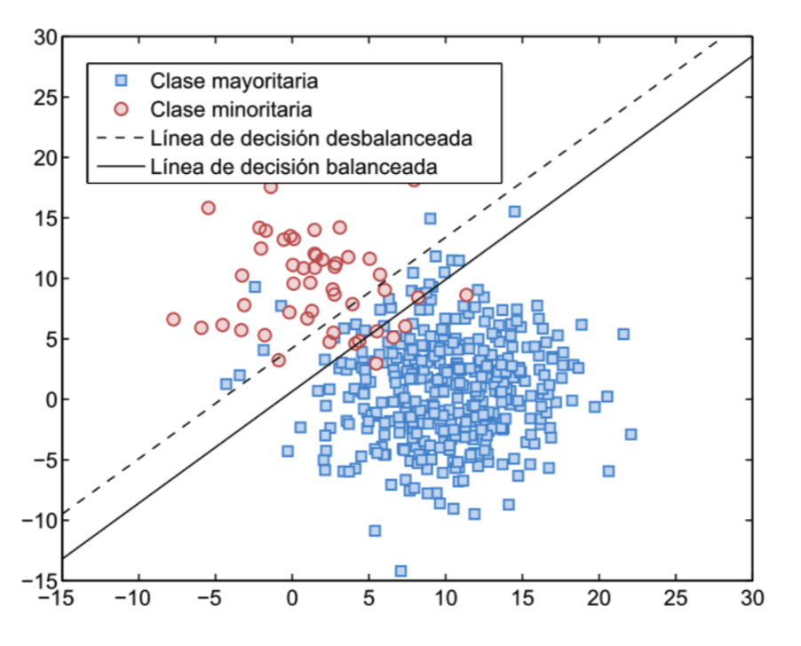
So, what is the problem?
This is a problem since most learning algorithms (this include ML and DL) assume that the dataset is relatively balanced and when this is not the case, the algorithm can be biased, affecting its generalization capacity and harming minority classes.
In practice there are many problems where the most important knowledge resides in the minority class. [2]

Slide 7
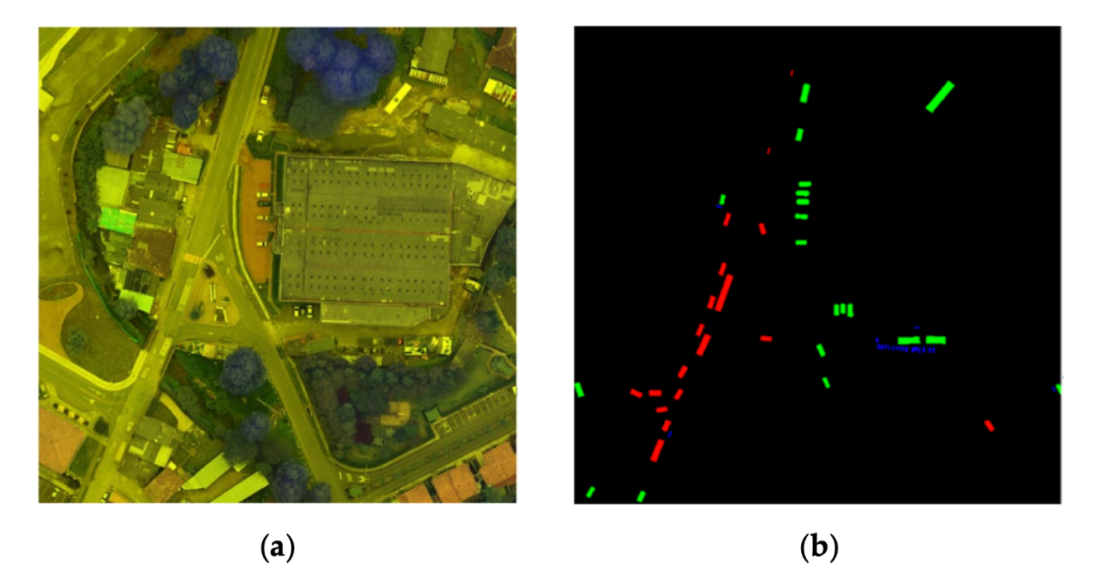
Imbalance in HAGDAVS
Figure 1. In this case we can see that at the pixel level the background class has a stronger presence than the other classes (cars, motorcycles and ghost), indicating an imbalance [1].

Slide 8
How to tackle the imbalance?
Data augmentation: creating additional training examples by applying various transformations or perturbations to the existing data. It helps increase the diversity and quantity of the training set.
Weight balancing: assigning different weights to different classes. By assigning higher weights to underrepresented classes, the model pays more attention to those samples.
Over and under sampling: Over-sampling involves replicating instances from the minority class to increase its representation, while under-sampling involves removing instances from the majority class to decrease its dominance.
Loss functions: can be used to give more importance to the minority class. For example, the weighted cross-entropy loss or focal loss assigns higher penalties to misclassifications of the minority class.
**Class balancing techniques are only really necessary when we actually care about the minority classes.

Slide 9
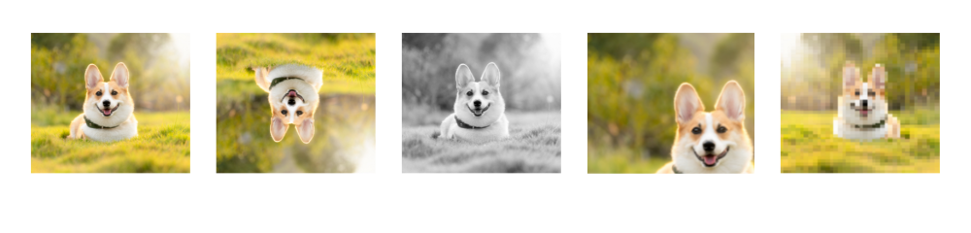
Data augmentation: What is?
Process of artificially increasing the amount of data by generating new data points from existing data. This includes adding minor alterations to data or using machine learning models to generate new data points in the latent space of original data to amplify the dataset. [3]
Synthetic data: When data is generated artificially without using real-world images. Synthetic data are often produced by Generative Adversarial Networks
Augmented data: Derived from original images with some sort of minor geometric transformations (such as flipping, translation, rotation, or the addition of noise) in order to increase the diversity of the training set

Slide 10
Data augmentation: Advantages and disadvantages
Advantages
Disadvantages
Augmented data is improving the performance and results of deep learning models by generating new and diverse instances for training datasets.
Reduces operating costs related to data collection
Data collection and data labeling can be time-consuming and expensive processes for deep learning models. Companies can cut operational expenses by transforming datasets using data augmentation techniques.
Cost of quality assurance of the augmented datasets.
Research and Development to build synthetic data with advanced applications.
Verification of image augmentation techniques like GANs is challenging.
Finding an optimal augmentation strategy for the data is non-trivial.
The inherent bias of original data persists in augmented data.

Slide 11
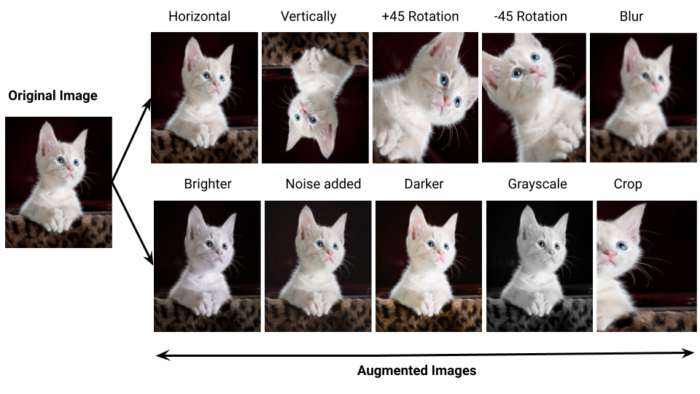
Data augmentation: Techniques in Computer Vision
1. Position Augmentation
Center Crop: Crops the given image at the center.
Random Crop: Crop the given image at a random location.
Random Vertical/Horizontal Flip: Vertically/Horizontally flips the given image randomly with a given probability.
Random Rotation: Rotate the image by some angle.
Resize: Resize the size of the input image to a given size.
2. Color Augmentation
Brightness: Change the brightness of the image. The resultant image becomes darker or lighter.
Contrast: degree of separation between the darkest and brightest areas of an image.
Saturation: Saturation is the separation between the colors of an image.

Slide 12
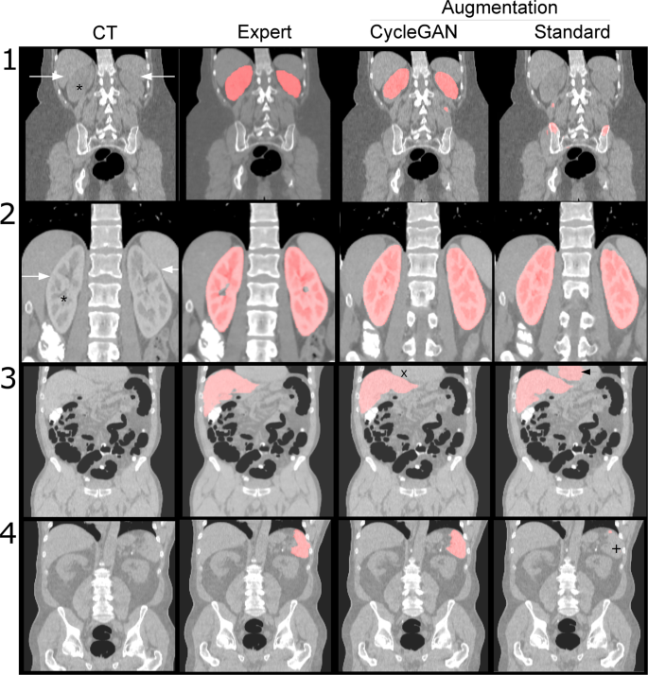
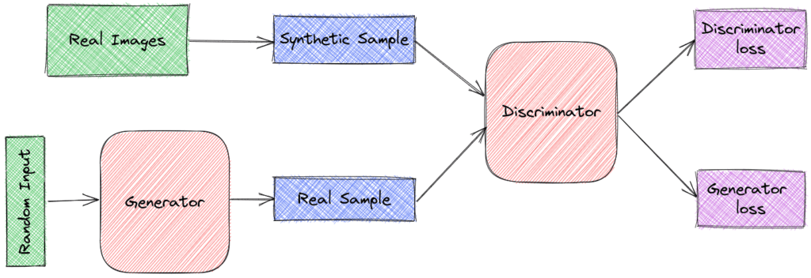
Data augmentation: GANs
The synthetic generated images by the GANs are used as augmented images for the input to the model. Is mandatory training the generator and discriminator and also the classifier (based on the use case). The downside to using GANs is that it needs high resource consumption and effort.
Figure 2. Data augmentation using GAN networks (CycleGAN) to improve generalizability in CT segmentation tasks [4].
Notes:
GAN: Consiste en dos componentes principales: el generador y el discriminador, que se entrenan en una competencia adversarial. El generador toma una entrada aleatoria, a menudo llamada "ruido", y trata de generar muestras de datos que se asemejen a los ejemplos reales del conjunto de datos de entrenamiento. Por otro lado, el discriminador recibe tanto muestras generadas por el generador como muestras reales del conjunto de datos. Su objetivo es distinguir entre las muestras generadas y las reales.
Durante el entrenamiento, el generador y el discriminador se actualizan en iteraciones sucesivas. El generador busca mejorar su capacidad para engañar al discriminador, generando muestras más realistas, mientras que el discriminador busca mejorar su capacidad para distinguir entre muestras generadas y reales. Esta competencia adversarial entre el generador y el discriminador conduce a un proceso de aprendizaje en el que el generador mejora gradualmente su habilidad para generar muestras que son cada vez más difíciles de distinguir de las muestras reales.
Using a large image database we trained a CycleGAN to transform contrast CT images into non-contrast images. We then used the trained CycleGAN to augment our training using these synthetic non-contrast images. We compared the segmentation performance of a U-Net trained on the original dataset compared to a U-Net trained on the combined dataset of original data and synthetic non-contrast images.

Slide 13
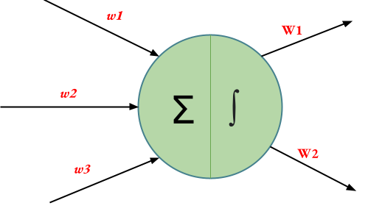
Weight balancing
Weight balancing helps mitigate this issue by assigning different weights to classes during training. During training, assign higher weights to the minority class and lower weights to the majority class.
The model then pays more attention to the minority class, as the loss associated with misclassifications is increased for that class.
Weighted Cross-Entropy Loss: Assigns higher weights to minority class samples in the loss calculation.
Focal Loss: Introduces a modulating factor that downplays well-classified samples and emphasizes hard-to-classify samples.
Notes:
Durante el entrenamiento, cada vez que se presenta un lote de datos, se utiliza la función de pérdida ponderada.
La función de pérdida toma en cuenta los pesos asignados a cada clase al calcular el error.
Esto implica que los errores en las clases minoritarias tienen un impacto mayor en la actualización de los pesos de la red neuronal.
Los errores en las clases minoritarias, que tienen un peso mayor, influyen más en el cálculo de los gradientes y, por lo tanto, en la actualización de los pesos.

Slide 14

Over and Under sampling
Disadvantage: It generates overfitting problems, due to the instances that are repeated in the dataset
Oversampling: It consists of selecting, randomly, data in the class minority and double them until the number of samples in both classes is similar.
Undersampling: It consists of selecting, randomly, data in the class majority and eliminate them until the number of samples in both classes is similar.
Disadvantage: Important instances can be lost in the random selection process

Slide 15
Custom loss functions: What is?
A loss function is a mathematical function that measures the difference between the predicted output of the model and the actual output. The goal of the deep learning model is to minimize this loss function. Different loss functions are used for different types of tasks and objectives. Loss functions quantify the error or loss of a neural network's predictions during training. They guide the network's optimization process by providing a signal for adjusting the model's parameters. For semantic segmentation some of the most used loss functions are:
Cross-Entropy Loss
Dice Loss
Jaccard Loss
Focal Loss
Tversky Loss
Weighted Cross-Entropy Loss

Slide 16
Custom loss functions: Some examples (links)
https://keras.io/api/losses/
https://github.com/maxvfischer/keras-image-segmentation-loss-functions/
https://github.com/nabsabraham/focal-tversky-unet/
https://github.com/JunMa11/SegLoss
https://github.com/raktim-mondol/loss-metrics

Slide 17
References
[1] J. R. Ballesteros, G. Sanchez-Torres, and J. W. Branch-Bedoya, “HAGDAVS: Height-Augmented Geo-Located Dataset for 388 Detection and Semantic Segmentation of Vehicles in Drone Aerial Orthomosaics,” Data, vol. 7, no. 4, Art. no. 4, Apr. 2022, doi: 38910.3390/data7040050.
[2] H. He, E.A. Garcia. “Learning from Imbalanced Data”
[3] https://www.v7labs.com/blog/data-augmentation-guide
[4] Sandfort, V., Yan, K., Pickhardt, P.J. et al. Data augmentation using generative adversarial networks (CycleGAN) to improve generalizability in CT segmentation tasks. Sci Rep 9, 16884 (2019). https://doi.org/10.1038/s41598-019-52737-x

Slide 18
Questions?

Slide 19
43

